Slide 1
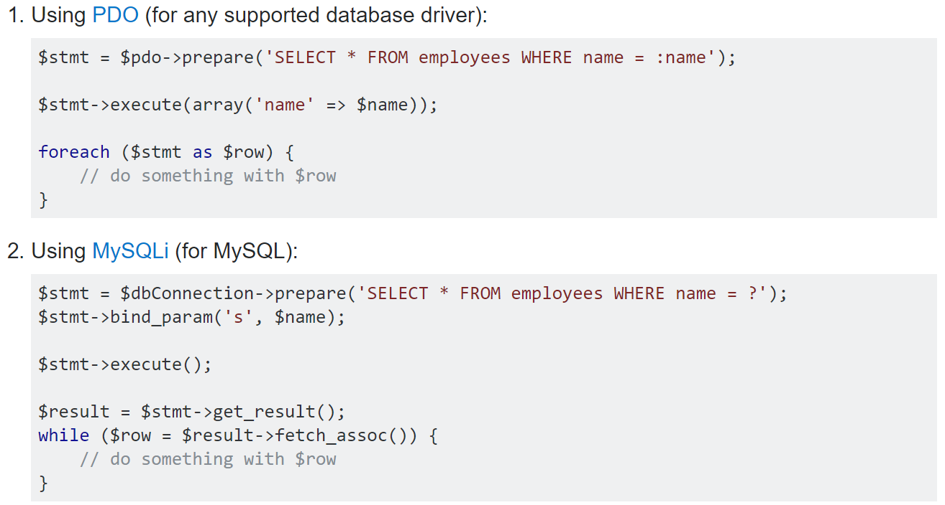
Prevent SQL injection

Slide 2
Prevent SQL injection

